Slide 1

Dynamic Programming
Dynamic Programming
Instructor: George Bebis

Slide 2
Dynamic Programming
An algorithm design technique (like divide and conquer)
Divide and conquer
  Partition the problem into independent subproblems
  Solve the subproblems recursively
  Combine the solutions to solve the original problem

Slide 3
Dynamic Programming
Applicable when subproblems are not independent
  Subproblems share subsubproblems
E.g.: Combinations:
  A divide and conquer approach would repeatedly solve the common subproblems
  Dynamic programming solves every subproblem just once and stores the answer in a table
n
k
=
n-1
k
n-1
k-1
+
n
1
=1
n
n
=1

Slide 4
Dynamic Programming
Used for optimization problems
  A set of choices must be made to get an optimal solution
  Find a solution with the optimal value (minimum or maximum)
  There may be many solutions that lead to an optimal value
  Our goal: find an optimal solution

Slide 5
Dynamic Programming Algorithm
Characterize the structure of an optimal solution
Recursively define the value of an optimal solution
Compute the value of an optimal solution in a bottom-up fashion
Construct an optimal solution from computed information (not always necessary)

Slide 6
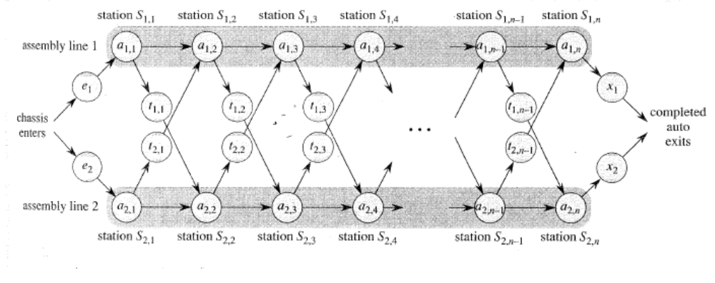
Assembly Line Scheduling
Automobile factory with two assembly lines
  Each line has n stations: S_{1,1}, . . . , S_{1,n} and S_{2,1}, . . . , S_{2,n}
  Corresponding stations S_{1, j} and S_{2, j} perform the same function but can take different amounts of time a_{1, j} and a_{2, j}
  Entry times are: e₁ and e₂; exit times are: x₁ and x₂

Slide 7
Assembly Line Scheduling
After going through a station, can either:
  stay on same line at no cost, or
  transfer to other line: cost after S_{i,j} is t_{i,j} , j = 1, . . . , n - 1

Slide 8
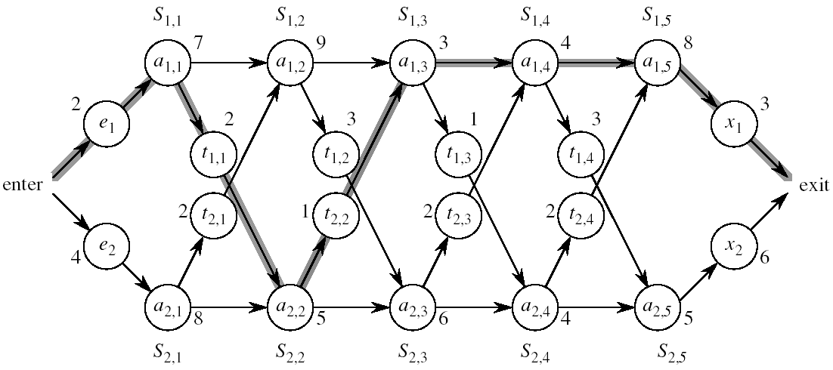
Assembly Line Scheduling
Problem:
what stations should be chosen from line 1 and which from line 2 in order to minimize the total time through the factory for one car?

Slide 9
One Solution
Brute force
  Enumerate all possibilities of selecting stations
  Compute how long it takes in each case and choose the best one
Solution:
  There are 2^{n} possible ways to choose stations
  Infeasible when n is large!!
1
2
3
4
n
1
0
0
1
1
0 if choosing line 2
at step j (= 3)
1 if choosing line 1
at step j (= n)

Slide 10
1. Structure of the Optimal Solution
How do we compute the minimum time of going through a station?

Slide 11
1. Structure of the Optimal Solution
Let’s consider all possible ways to get from the starting point through station S_{1,j}
  We have two choices of how to get to S_{1, j}:
    Through S_{1, j - 1}, then directly to S_{1, j}
    Through S_{2, j - 1}, then transfer over to S_{1, j}
S_{1,j-1}
S_{1,j}
Line 1
a_{1,j-1}
a_{1,j}
t_{2,j-1}
Line 2
a_{2,j-1}
S_{2,j-1}

Slide 12
1. Structure of the Optimal Solution
Suppose that the fastest way through S_{1, j} is through S_{1, j – 1}
  We must have taken a fastest way from entry through S_{1, j – 1}
  If there were a faster way through S_{1, j - 1}, we would use it instead
Similarly for S_{2, j – 1}
S_{1,j-1}
S_{1,j}
Line 1
a_{1,j-1}
a_{1,j}
Optimal Substructure
t_{2,j-1}
a_{2,j-1}
Line 2
S_{2,j-1}

Slide 13
Optimal Substructure
Generalization: an optimal solution to the problem “find the fastest way through S_{1, j}” contains within it an optimal solution to subproblems: “find the fastest way through S_{1, j - 1} or S_{2, j – 1}”.
This is referred to as the optimal substructure property
We use this property to construct an optimal solution to a problem from optimal solutions to subproblems

Slide 14
2. A Recursive Solution
Define the value of an optimal solution in terms of the optimal solution to subproblems

Slide 15
2. A Recursive Solution (cont.)
Definitions:
  f* : the fastest time to get through the entire factory
  f_{i}[j] : the fastest time to get from the starting point through station S_{i,j}
  f* = min (f₁[n] + x₁, f₂[n] + x₂)

Slide 16
2. A Recursive Solution (cont.)
Base case: j = 1, i=1,2 (getting through station 1)
f₁[1] = e₁ + a_{1,1}
f₂[1] = e₂ + a_{2,1}

Slide 17
2. A Recursive Solution (cont.)
General Case: j = 2, 3, …,n, and i = 1, 2
Fastest way through S_{1, j} is either:
  the way through S_{1, j - 1} then directly through S_{1, j}, or
  f₁[j - 1] + a_{1,j}
  the way through S_{2, j - 1}, transfer from line 2 to line 1, then through S_{1, j}
f₂[j -1] + t_{2,j-1} + a_{1,j}
f₁[j] = min(f₁[j - 1] + a_{1,j} ,f₂[j -1] + t_{2,j-1} + a_{1,j})
S_{1,j-1}
S_{1,j}
Line 1
a_{1,j-1}
a_{1,j}
t_{2,j-1}
a_{2,j-1}
Line 2
S_{2,j-1}

Slide 18
2. A Recursive Solution (cont.)
e₁ + a_{1,1} if j = 1
f₁[j] =
min(f₁[j - 1] + a_{1,j} ,f₂[j -1] + t_{2,j-1} + a_{1,j}) if j ≥ 2
e₂ + a_{2,1} if j = 1
f₂[j] =
min(f₂[j - 1] + a_{2,j} ,f₁[j -1] + t_{1,j-1} + a_{2,j}) if j ≥ 2

Slide 19
3. Computing the Optimal Solution
  f* = min (f₁[n] + x₁, f₂[n] + x₂)
f₁[j] = min(f₁[j - 1] + a_{1,j} ,f₂[j -1] + t_{2,j-1} + a_{1,j})
f₂[j] = min(f₂[j - 1] + a_{2,j} ,f₁[j -1] + t_{1,j-1} + a_{2,j})
Solving top-down would result in exponential running time
1
2
3
4
5
f₁[j]
f₁(1)
f₁(2)
f₁(3)
f₁(4)
f₁(5)
f₂[j]
f₂(1)
f₂(2)
f₂(3)
f₂(4)
f₂(5)
4 times
2 times

Slide 20
3. Computing the Optimal Solution
For j ≥ 2, each value f_{i}[j] depends only on the values of f₁[j – 1] and f₂[j - 1]
Idea: compute the values of f_{i}[j] as follows:
Bottom-up approach
  First find optimal solutions to subproblems
  Find an optimal solution to the problem from the subproblems
in increasing order of j
1
2
3
4
5
f₁[j]
f₂[j]

Slide 21
Example
e₁ + a_{1,1}, if j = 1
f₁[j] = min(f₁[j - 1] + a_{1,j} ,f₂[j -1] + t_{2,j-1} + a_{1,j}) if j ≥ 2
1
2
3
4
5
f₁[j]
9
18^{[1]}
20^{[2]}
24^{[1]}
32^{[1]}
f* = 35^{[1]}
f₂[j]
12
16^{[1]}
22^{[2]}
25^{[1]}
30^{[2]}

Slide 22
Construct an Optimal Solution
1
2
3
4
5
f₁[j]/l₁[j]
9
18^{[1]}
20^{[2]}
24^{[1]}
32^{[1]}
l* = 1
f₂[j]/l₂[j]
12
16^{[1]}
22^{[2]}
25^{[1]}
30^{[2]}

